Slide 1
Diabetes Prediction using ML
Abhimaan Mayadam

Slide 2
Outline
Introduction
Descriptive Statistics
Machine Learning
Results
Final Takeaways

Slide 3
Introduction
Diabetes affects a large portion of the world
Both as a direct disease and the increased risks to health

Slide 4
Diabetes Diagnosis using ML
My term project is focusing on the diagnosis and trying to predict diabetes using machine learning.

Slide 5
Pima Indians dataset
Collected in the mid to late 90s in Phoenix, Arizona
768 observations on 9 variables

Slide 6
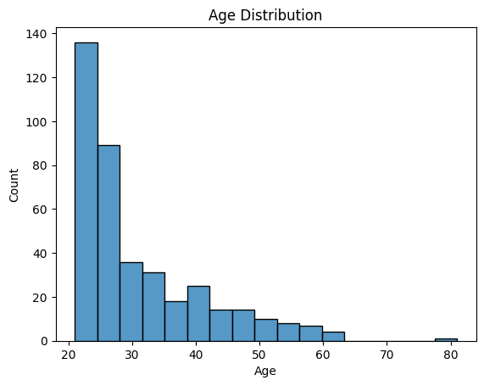
Age Distribution of Pima Indians

Slide 7
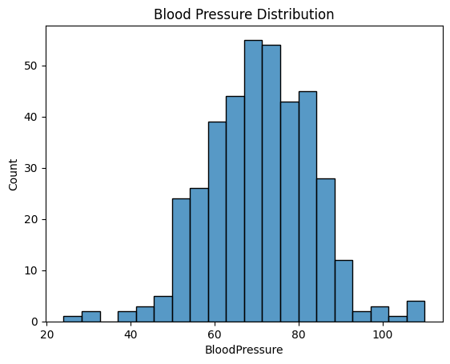
Blood Pressure distribution

Slide 8
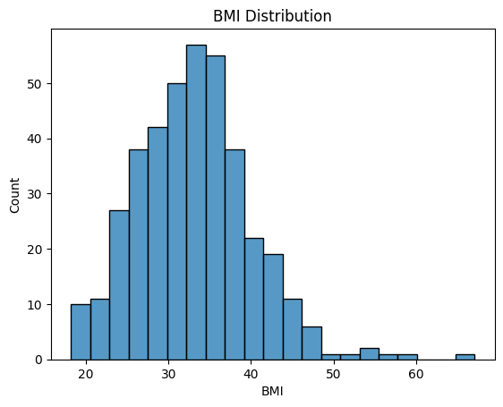
BMI distribution

Slide 9
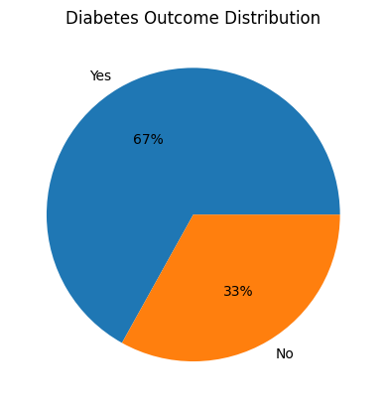
Diabetes Spread

Slide 10
Machine Learning
Models Chosen:
Naïve Bayes
Decision Tree
Untuned and Tuned

Slide 11
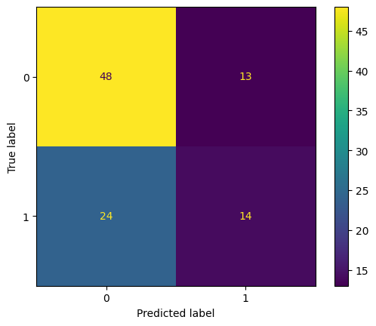
Naïve Bayes
Gaussian Naïve Bayes model was chosen
75/25 split used for training
Accuracy: 0.758
Precision: 0.667
Recall: 0.545
F1 Score: 0.600

Slide 12
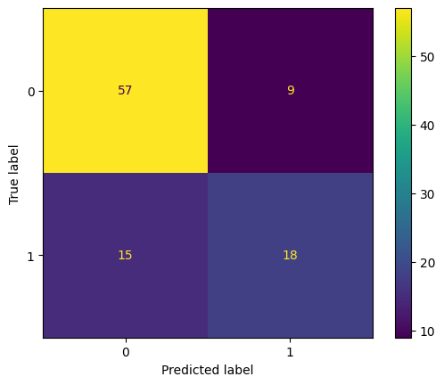
SCALEd Naïve Bayes
Gaussian Naïve Bayes model was chosen
75/25 split used for training
Accuracy: 0.758
Precision: 0.667
Recall: 0.545
F1 Score: 0.600

Slide 13
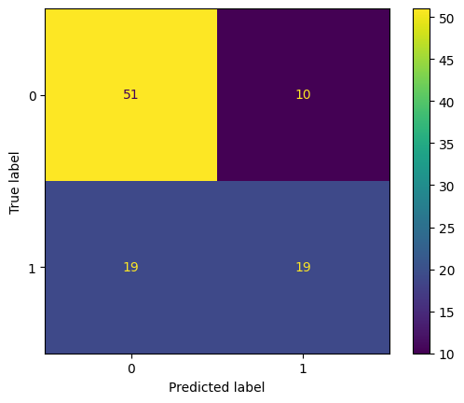
Decision Tree
Variables were minmax scaled
Untuned
Accuracy: 0.707
Precision: 0.655
Recall: 0.500
F1 Score: 0.567

Slide 14
Tuned Decision Tree
Variables were minmax scaled
Accuracy: 0.73955
Precision: 0.646482
Recall: 0.631475
F1 Score: 0.633318

Slide 15
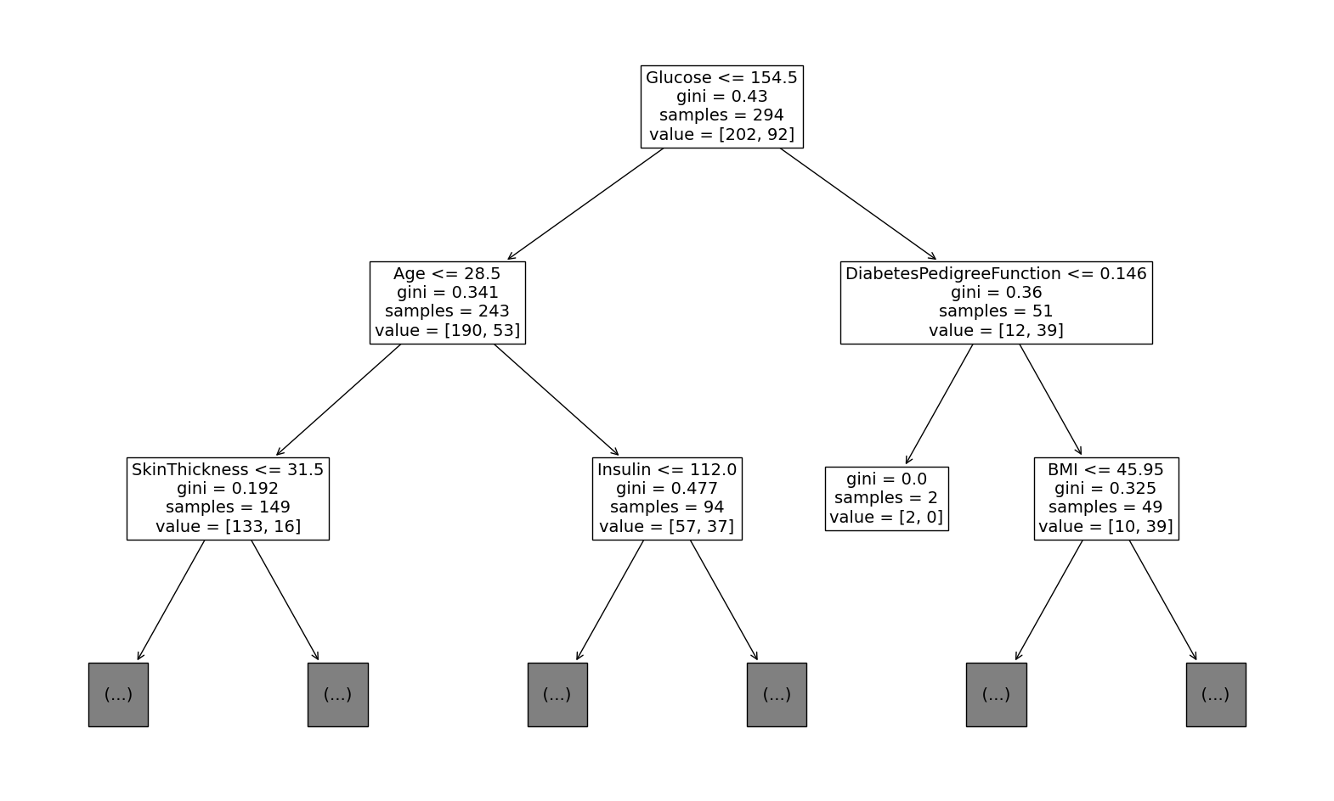
Best Performing Decision TREE

Slide 16
Conclusion
Utilizing ML to accurately predict diabetes diagnoses can be demonstrated.
A larger dataset might have resulted in a better performing set of models.

